Slide 1
Autonomous Research Data Curation
Multi-Agent AI Systems for FAIR Compliance at HPC Scale
Name
Chris Snow

Slide 2

About Your Speaker
I help organizations move beyond the whiteboard to build and deploy real-world AI solutions.
My 25+ years in IT, including key roles at Databricks, HPE, and IBM Cloud, have been focused on a single goal: turning ambitious data strategies into tangible, production-ready outcomes.
I go beyond architecture to deliver the code, demos, and documentation that empower technical teams and drive business value.
See my projects in action:
📂 GitHub: github.com/snowch
Chris Snow
Bridging Data Strategy and Hands-On Implementation

Slide 3

The Research Data Crisis
University HPC centers generate petabytes of undiscoverable data
80% of data remains undiscoverable and non-FAIR compliant
PhD students spend months on data engineering
AI can automate what human efforts cannot scale

Slide 4
The Research Data Crisis
A DiRAC Priority
Shared Problem:
DiRAC's report validates the "research data crisis," citing the struggle to manage and curate massive datasets across key scientific domains.
Curation is a Stated Need:
The report explicitly calls for dedicated data curation resources to achieve FAIR data standards, a central pillar of the proposed solution.
Metadata as a Bottleneck:
DiRAC identifies the lack of standardized metadata as a major barrier to data reuse, a problem this multi-agent AI system is designed to solve through automated metadata generation.
A Timely Solution:
Autonomous curation offers a direct and tangible solution to DiRAC's call for a more intelligent, automated, and FAIR-compliant data infrastructure.
Requirements for the Future DRI Ecosystem March 2024

Slide 5
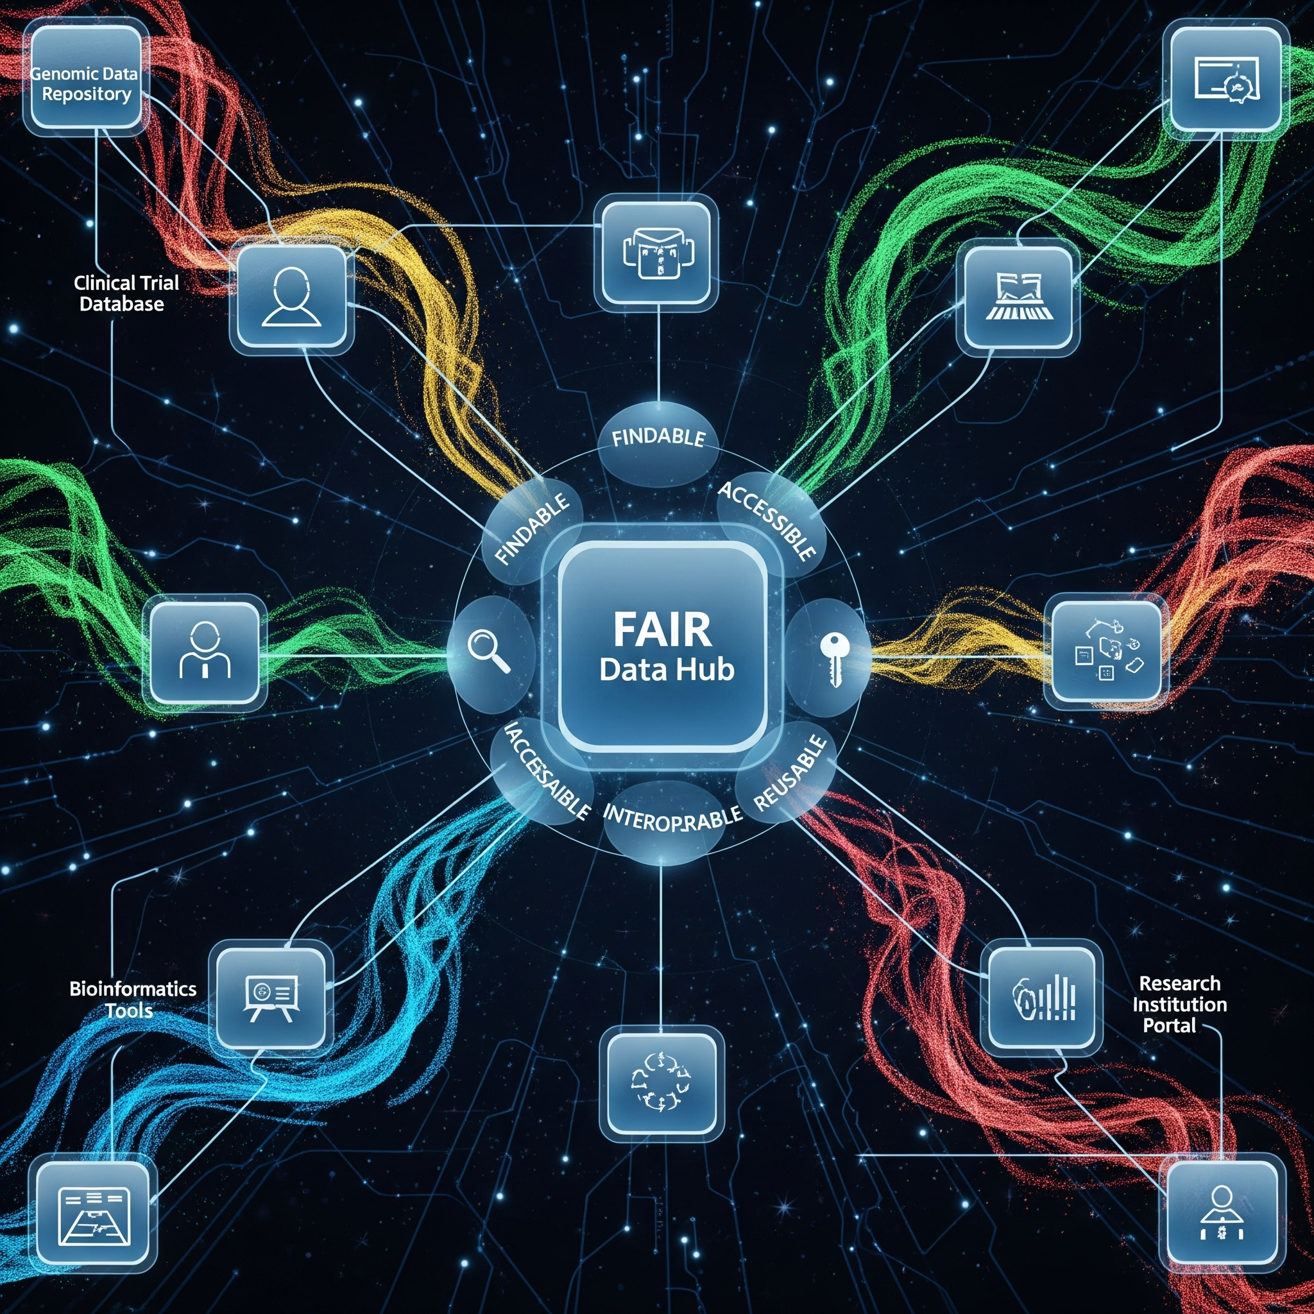
Practical FAIR Compliance
Findable: Full-text and semantic search capabilities.
Accessible: Standard protocols, licensing, and APIs.
Interoperable: Consistent metadata standards in Vast Database.
Reusable: Documented provenance, lineage, and processing history.

Slide 6

VAST’s DASE Architecture
Linear scalability for all workloads
Unified, all-flash data access
Decoupled compute and storage
Real-time performance at archive economics
Disaggregated, Shared-Everything
Advancing the World Beyond the Tradeoffs of Shared-Nothing Clusters
Memory-Free Architecture
Notes:
Now, let's look at the innovation underpinning all of this: our DASE architecture, which stands for Disaggregated, Shared Everything. This is the core of VAST's revolutionary data architecture, where we've completely separated compute from storage.
What does this mean for vector search? All our compute nodes (C-Nodes) directly access a shared, global, all-flash data pool over NVMe over Fabrics. This direct, high-speed access eliminates bottlenecks and provides unprecedented performance for your vector workloads.
Crucially, DASE delivers
linear scalability for all workloads. Whether it's real-time vector search, event streaming, transactional databases, or parallel file services, you can scale compute and storage independently to meet demand – with no re-partitioning or re-indexing ever required.
This also results in a
Memory-Free Architecture. We eliminate the operational burdens of complex sharding, manual rebalancing, or memory-bound GPU indexes, dramatically simplifying management and freeing up valuable engineering resources for your AI initiatives

Slide 7
VAST Data Platform
Multi-Tenant, Data/AI Services
SaaS Services
Agentic & Generative AI Services | AI SaaS Apps
Cyber Security, CoPilot, Document RAG, Vision/Video AI, CX Agent
AgentEngine
Agent Tools & Orchestration
DataStore
DataBase
DataEngine
InsightEngine
Multi-Protocol File & Object Storage
A Transactional Data Warehouse & Vector Database
Parallel, Containerized Computing
Hosted RAG & AI Inference
Storage Services
High-performance file, object, S3
Cyber Recovery Services
Instant recovery from ransomware
Managed SQL
Database, analytics services
Managed Kafka
Integrated event streaming services
Managed Spark
Integrated data processing services
Managed K8S
Application container hosting
Managed RAG
Integrated AI inference services
IaaS Services
PaaS Services
Notes:
VAST is a data platform that allows businesses to store, protect, analyze, train and infer their data from on-prem to cloud. Leveraging the first new modern architecture in 20 years, the VAST Data Platform provides customers exabyte scale, hard drive levels of efficiency for all-flash, a parallel transactional and analytical architecture that extends consistent namespaces from edge to cloud. With VAST, customers no longer need to deal with the complexity and silos of data tiering, they can consolidate file, object and transactional datawarehouse infrastructure into one synthesized and scalable view of data, and program their data using scalable, containerized computing that has support for standard interfaces such as enterprise NAS, SQL and more.

Slide 8
FAIR Metadata Generation
Up Next
How to generate metadata in (near) real time?

Slide 9

Solution Architecture
S3 Dataset Folder
Multi-Agent Curation Service
Route & dependency check
Subfolder (e.g. raw_data/)
VAST Catalog
Catalog Curation Orchestrator
Orchestrator Agent
Review Agent
VAST Database
S3 ObjectCreated
triggers
Route & dependency check
Metadata JSON
New / Updated File
S3 Event Notification
Realtime Curation Orchestrator
Data Enrichment Agent
Context Agent
Boundary Agent
Metadata Aggregator & PDF Generator
S3 ObjectCreated (PDF)
triggers ingestion
folder_metadata.pdf
VAST Document RAG (Insight Engine)
update/create PDF

Slide 10
Example Agents
Data Enrichment Agent
Extracts metadata from scientific files (HDF5, NetCDF, etc.)
Boundary Agent
Maps folder hierarchy and determines scope
Context Agent
- Mines companion documents (READMEs, scripts, citations)
Review Agent
Processes existing folder_metadata.pdf
Orchestrator Agent
Coordinates everything and generates updated PDF

Slide 11
Folder metadata create/update process
The VAST Data Platform
VAST Data Engine
VAST Kafka Topic
File Notification Listener
(VAST Trigger
Argent Orchestrator
(VAST Function)
AI Agent Pool
2
3
4
Message Consumed by Trigger
Invokes Function
Invoke AI Agent
6
Persist Processing Metadata to DB
5
Creates/Updates
Folder_metadata.pdf
Incoming Data Bucket
(VAST S3)
Processing Metadata
Curated Metadata Bucket
(VAST S3)
1
Publishes File Event
Data Services
Notes:
graph TD;
%% Info: Final architecture using Kafka as the event bus between the S3 event and the VAST Trigger.
%% Title: Kafka-Driven AI Curation Pipeline on the VAST Platform
subgraph "The VAST Data Platform"
direction LR
subgraph "Data Services"
direction TB
s3_incoming("Incoming Data Bucket<br>(VAST S3)"):::db_blue;
s3_curated("Curated Metadata Bucket<br>(VAST S3)"):::db_green;
vast_db("Processing Metadata<br>(VAST DataBase)"):::db_blue;
end
subgraph "VAST Data Engine"
direction TB
kafka("🚀 VAST Kafka Topic"):::event_bus;
vast_trigger("⚡ File Notification Listener<br>(VAST Trigger)"):::cpu_red;
orchestrator("🎯 Agent Orchestrator<br>(VAST Function)"):::cpu_red;
agent_pool("🤖 AI Agent Pool"):::cpu_purple;
end
%% Main Workflow within the Platform
s3_incoming -- "1. Publishes<br>File Event" --> kafka;
kafka -- "2. Message<br>Consumed<br>by Trigger" --> vast_trigger;
vast_trigger -- "3. Invokes<br>Function" --> orchestrator;
orchestrator -- "4. Invoke<br>AI Agents" --> agent_pool;
agent_pool -- "5. Creates/Updates 'folder_metadata.pdf'" --> s3_curated;
%% s3_curated -- "6. Returns PDF location" --> orchestrator;
orchestrator -- "6. Persist<br>Processing<br>Metadata to DB" --> vast_db;
end
%% Styling
classDef db_blue fill:#1E90FF,color:#fff,stroke:#333,stroke-width:2px;
classDef db_green fill:#2E8B57,color:#fff,stroke:#333,stroke-width:2px;
classDef cpu_red fill:#DC143C,color:#fff,stroke:#333,stroke-width:2px;
classDef cpu_purple fill:#8A2BE2,color:#fff,stroke:#333,stroke-width:2px;
classDef event_bus fill:#9370DB,color:#fff,stroke:#333,stroke-width:2px;

Slide 12
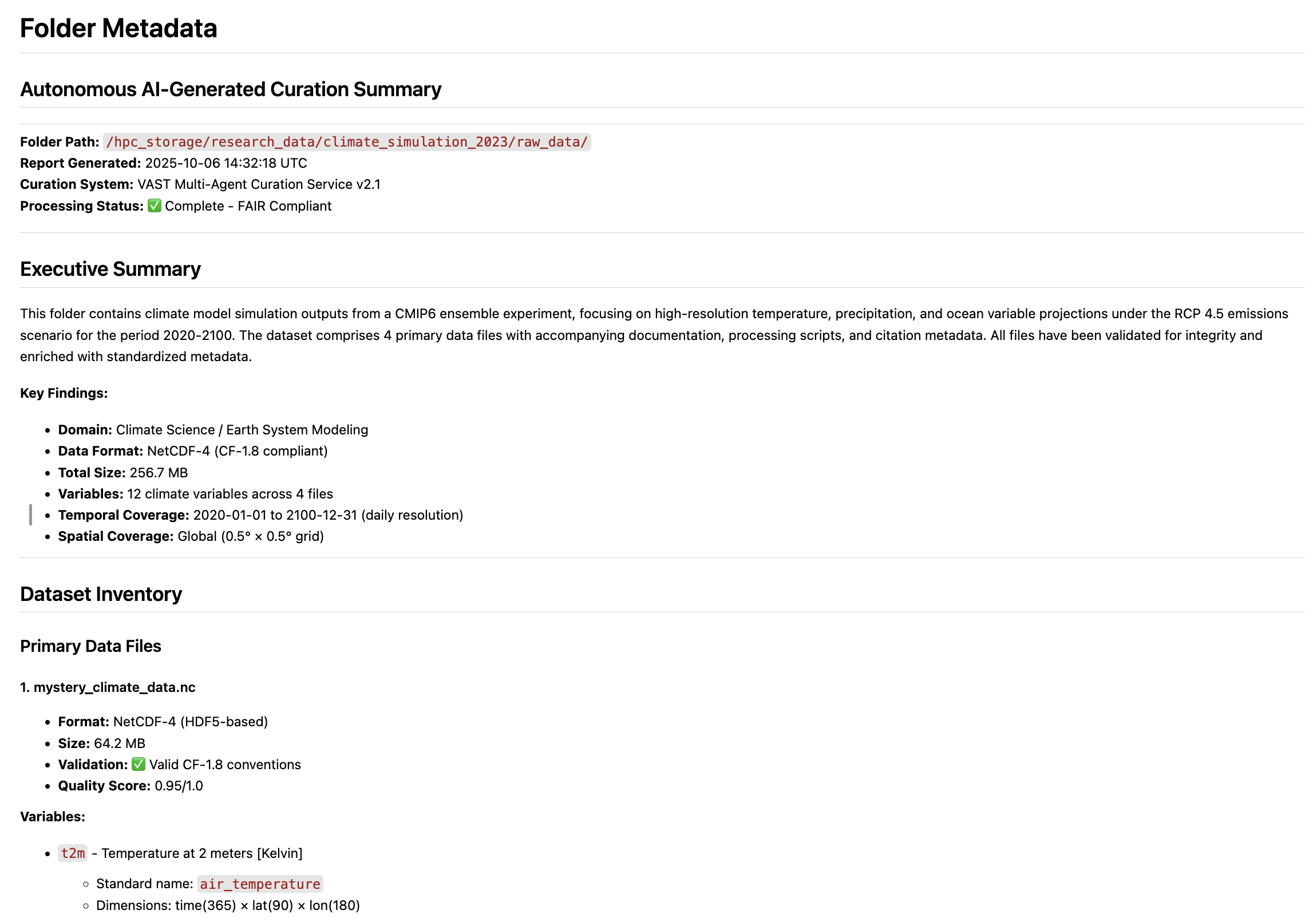
Example folder metadata file

Slide 13
Demo: Triggers and Functions
Up Next
VAST DataEngine Pipeline builder

Slide 14
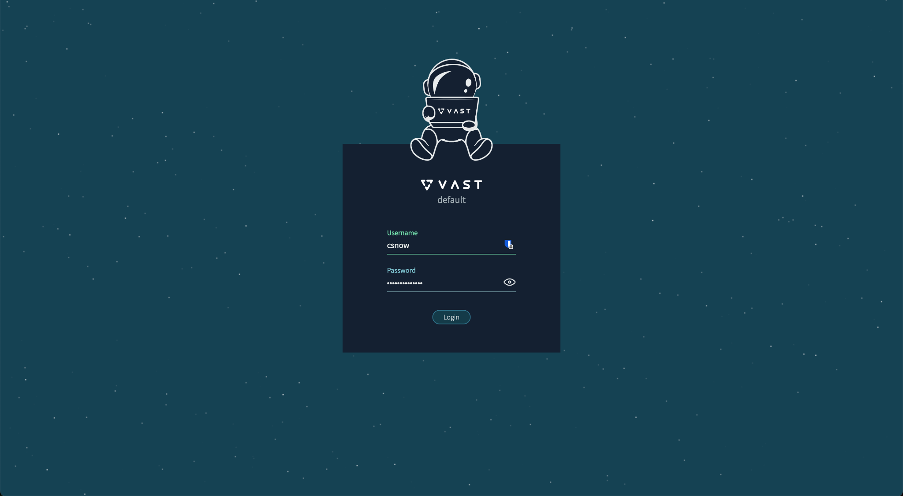

Slide 15
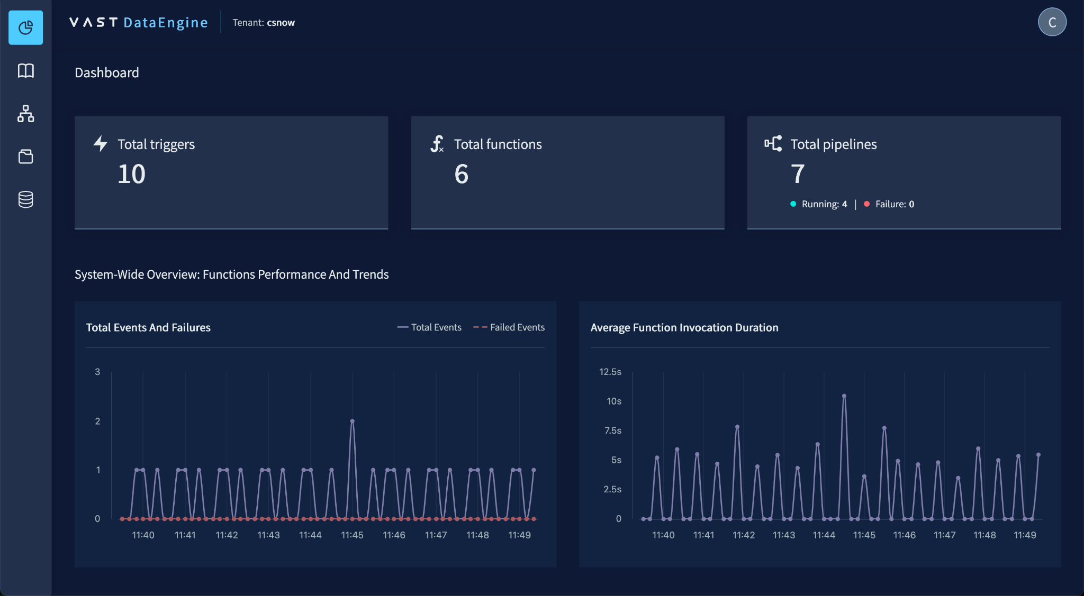

Slide 16
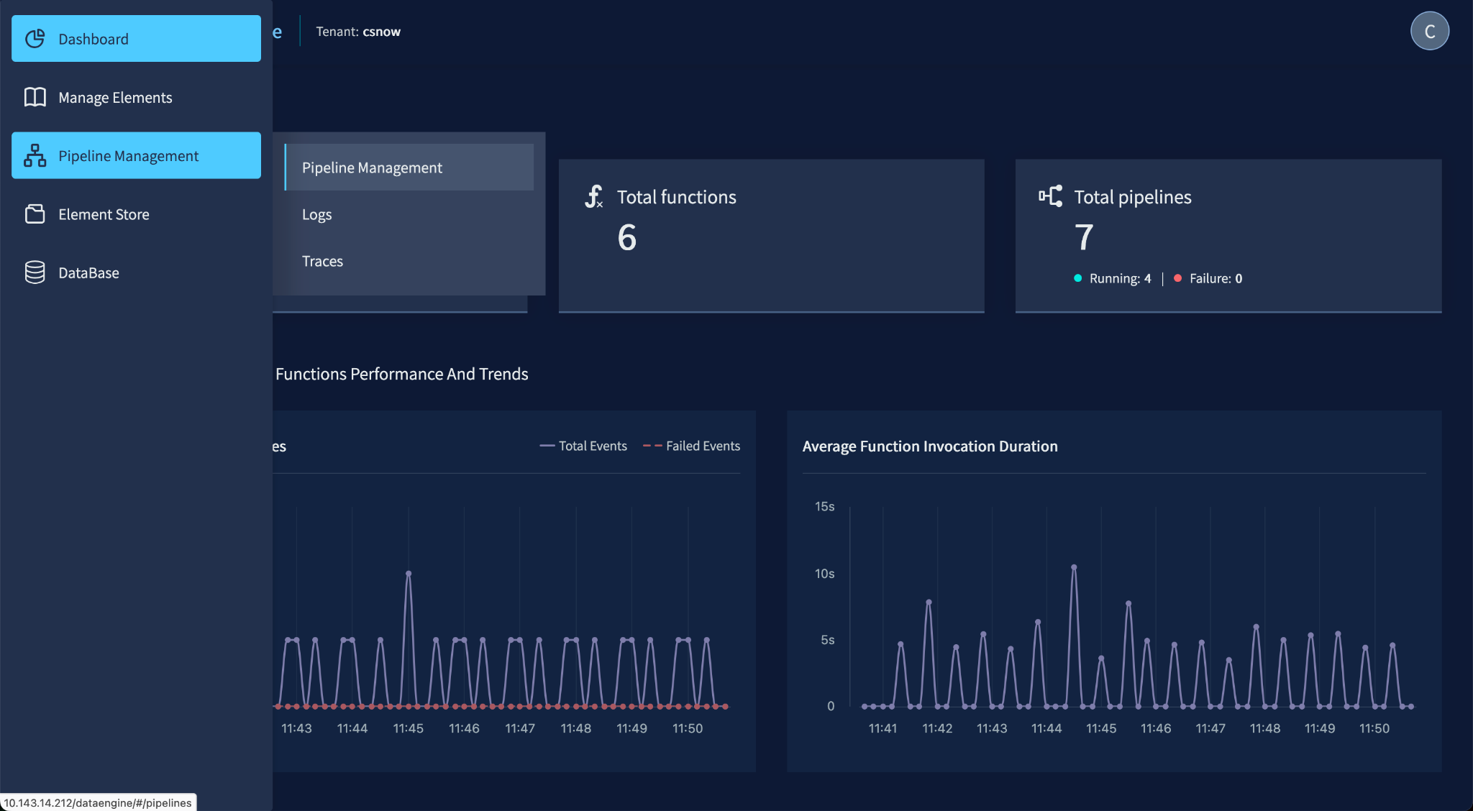

Slide 17
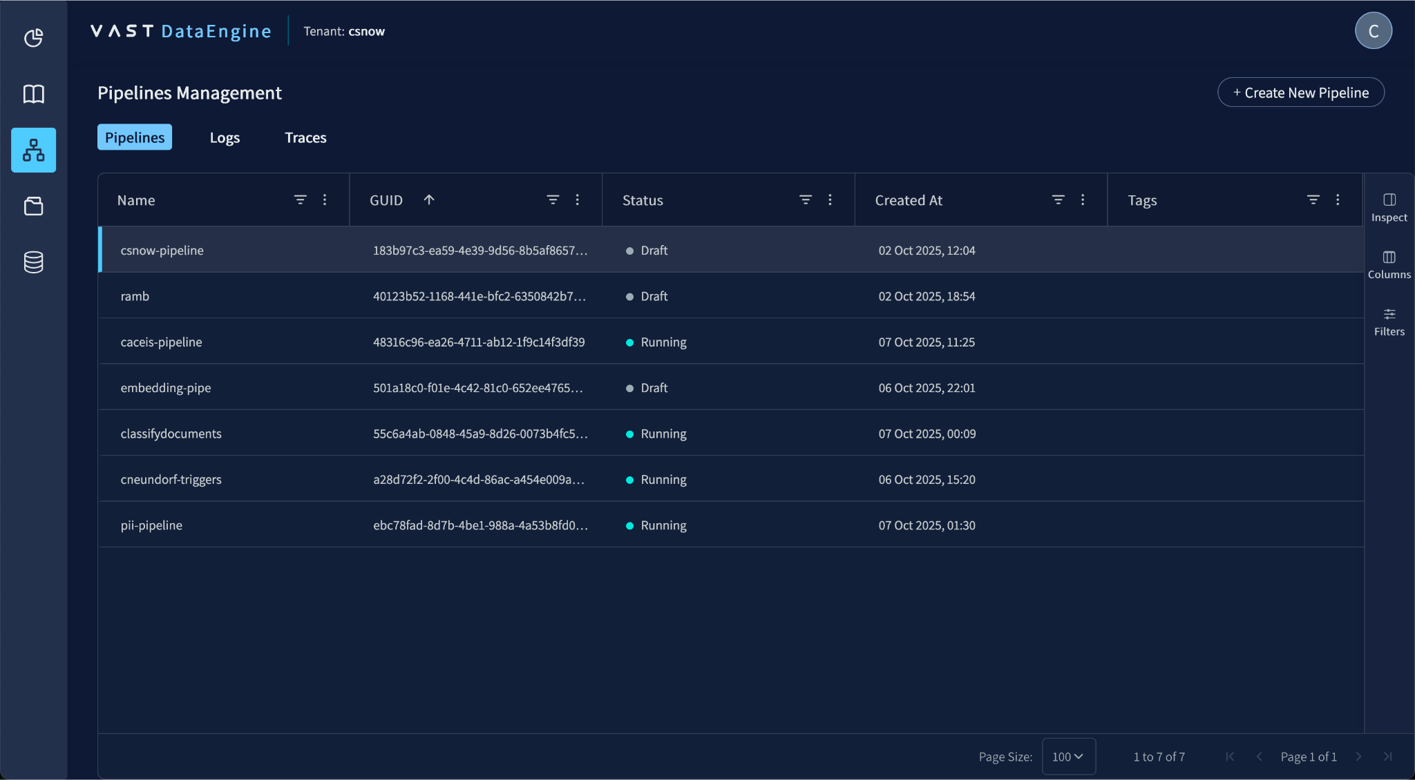

Slide 18
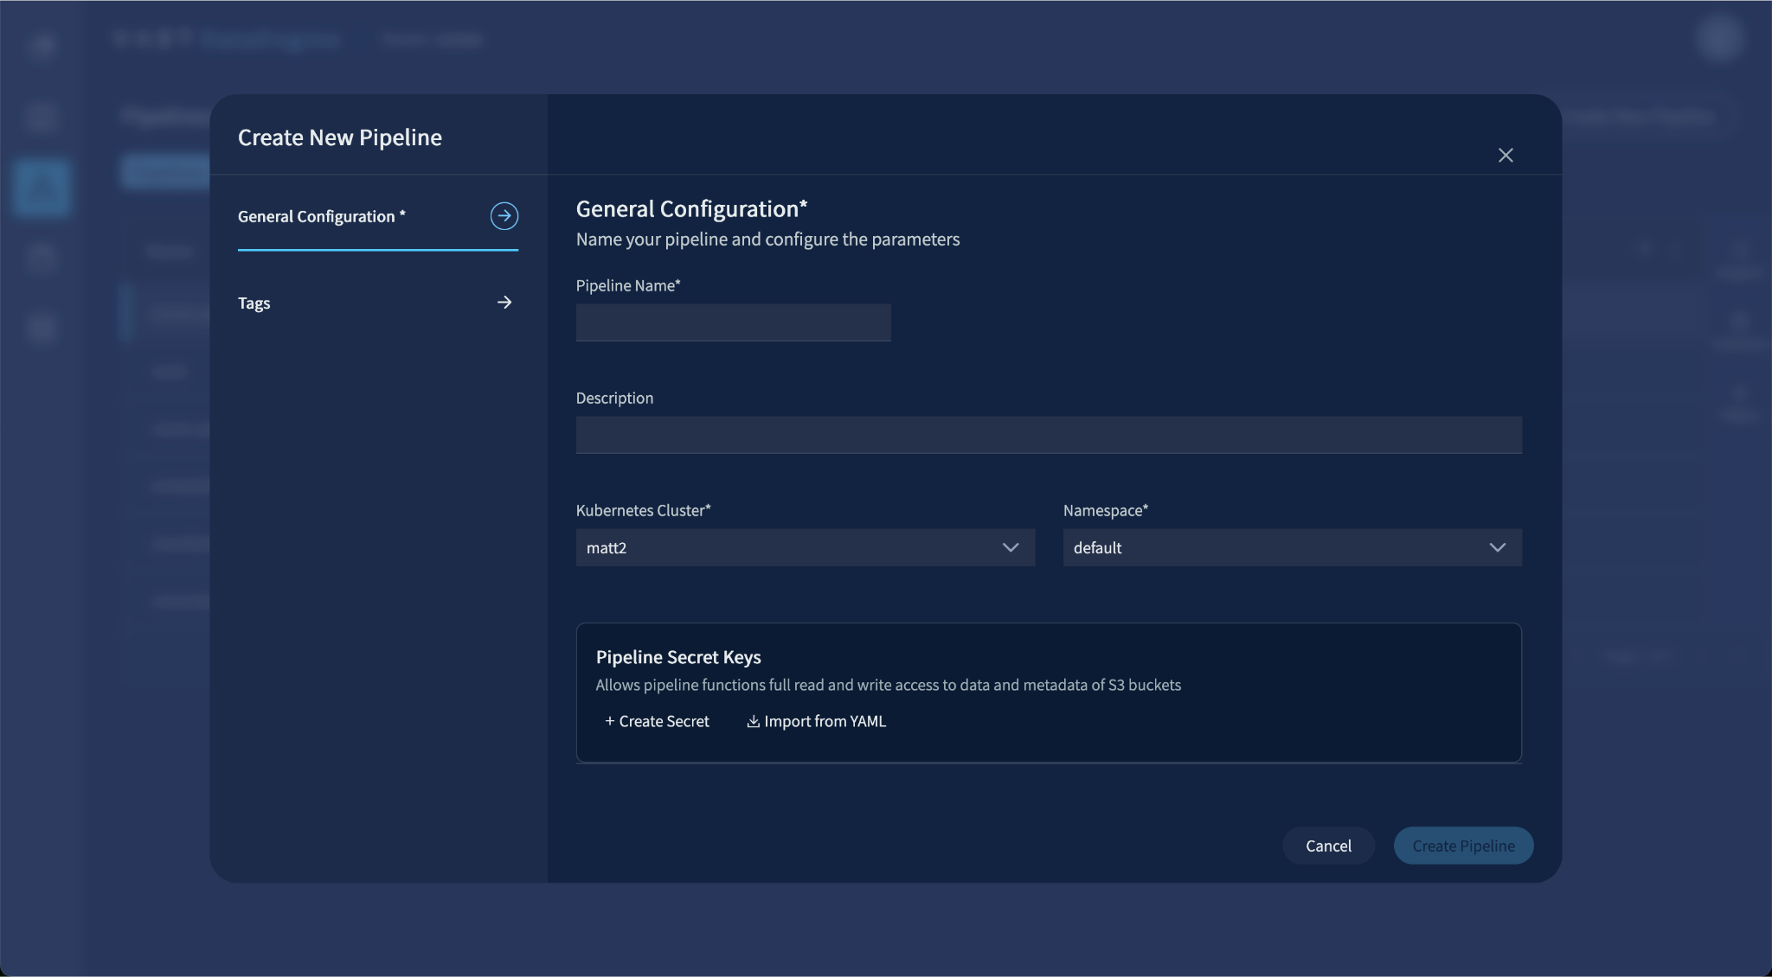

Slide 19
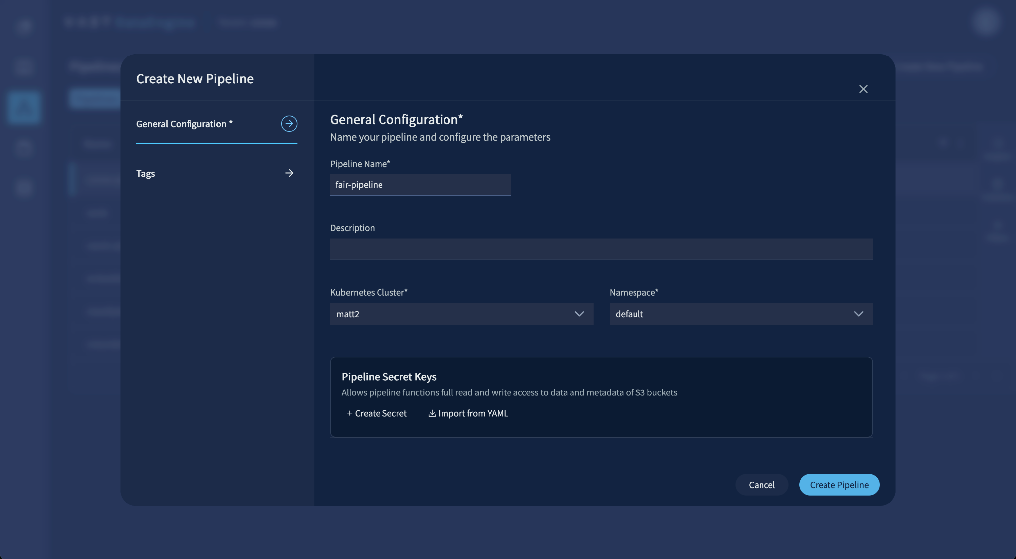

Slide 20
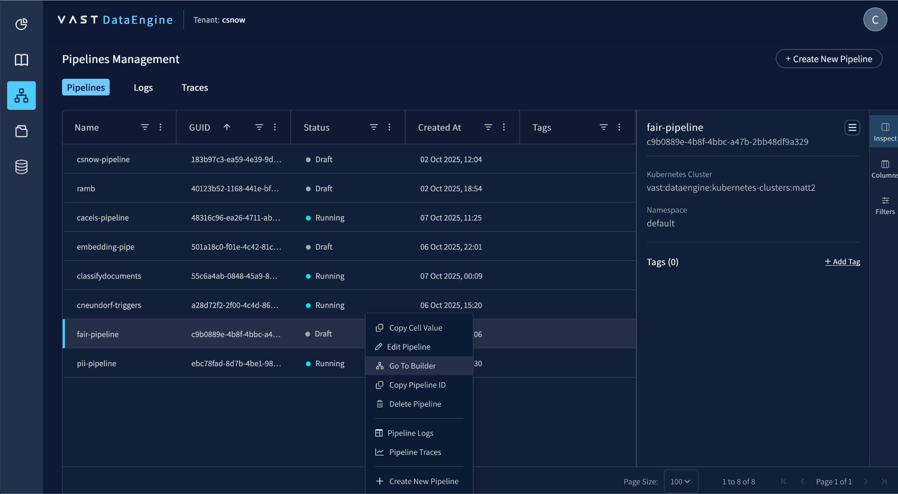

Slide 21
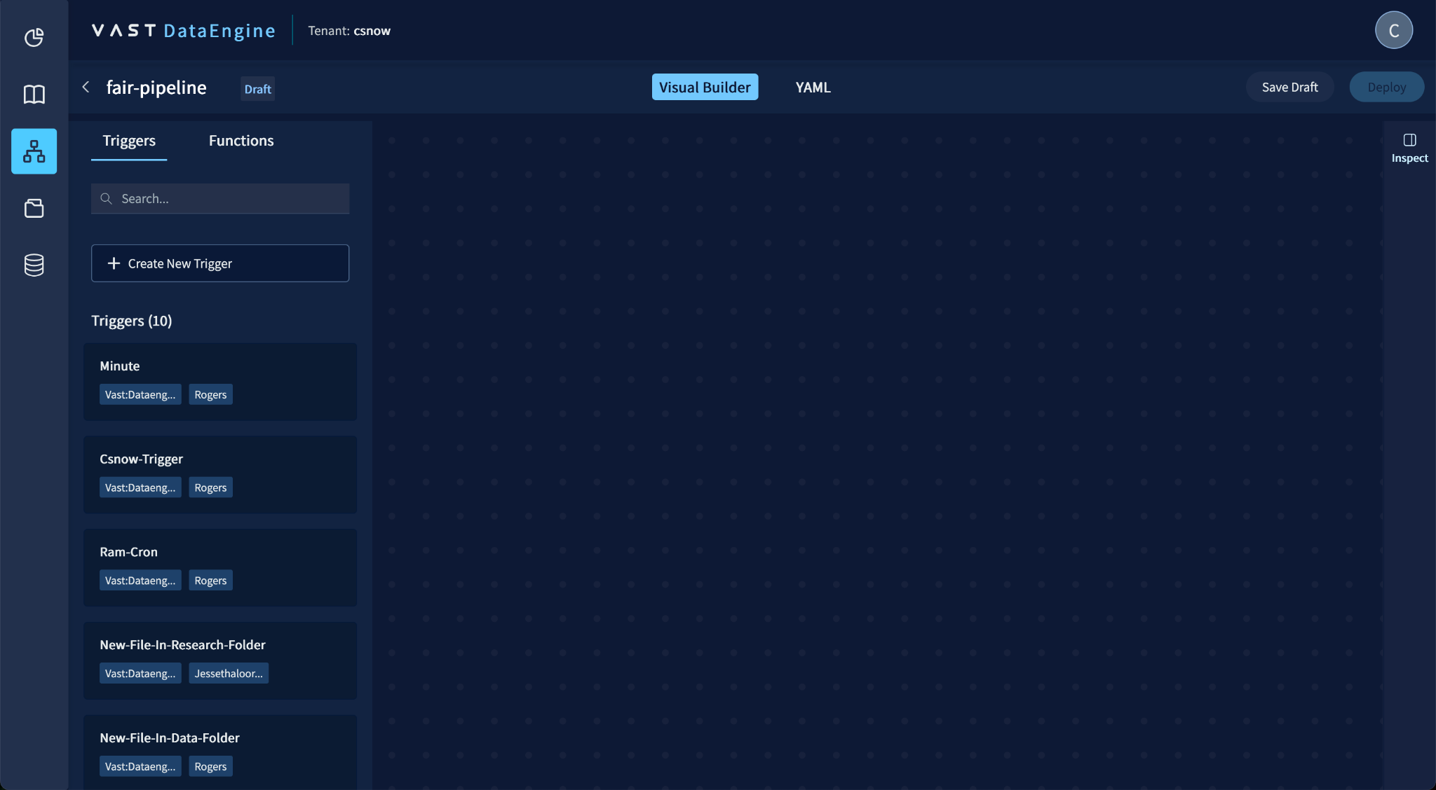

Slide 22
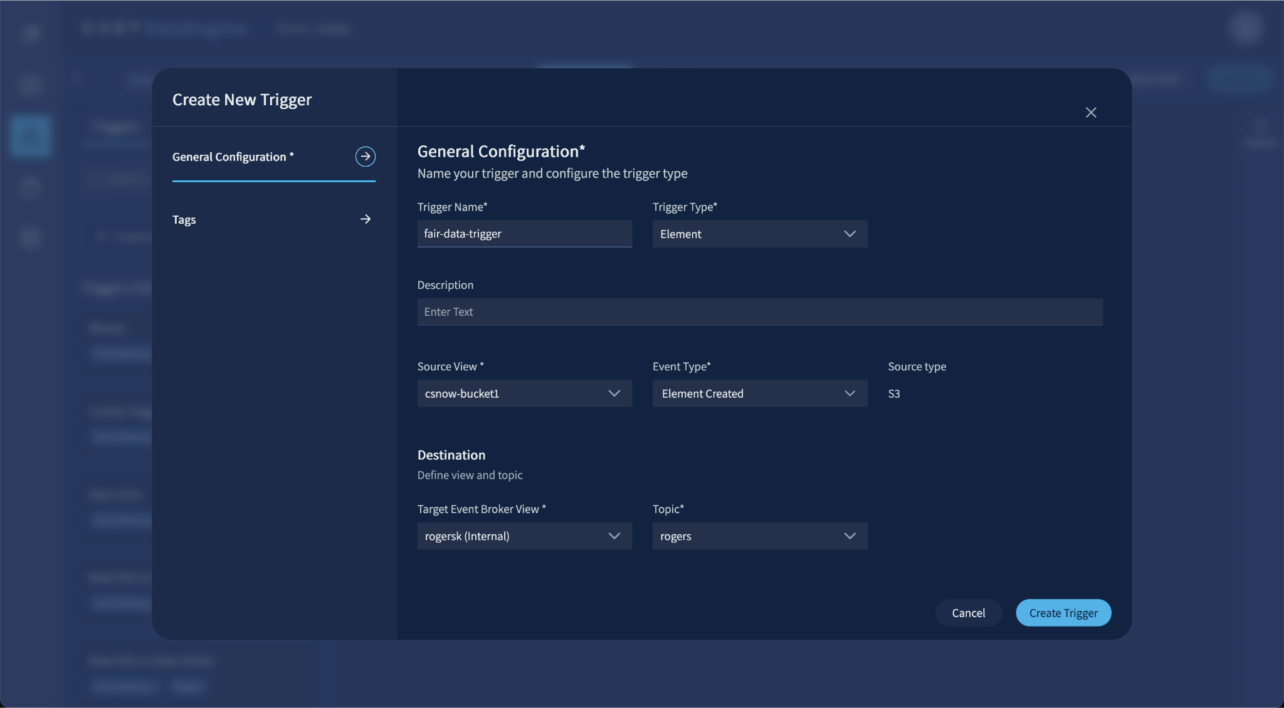

Slide 23
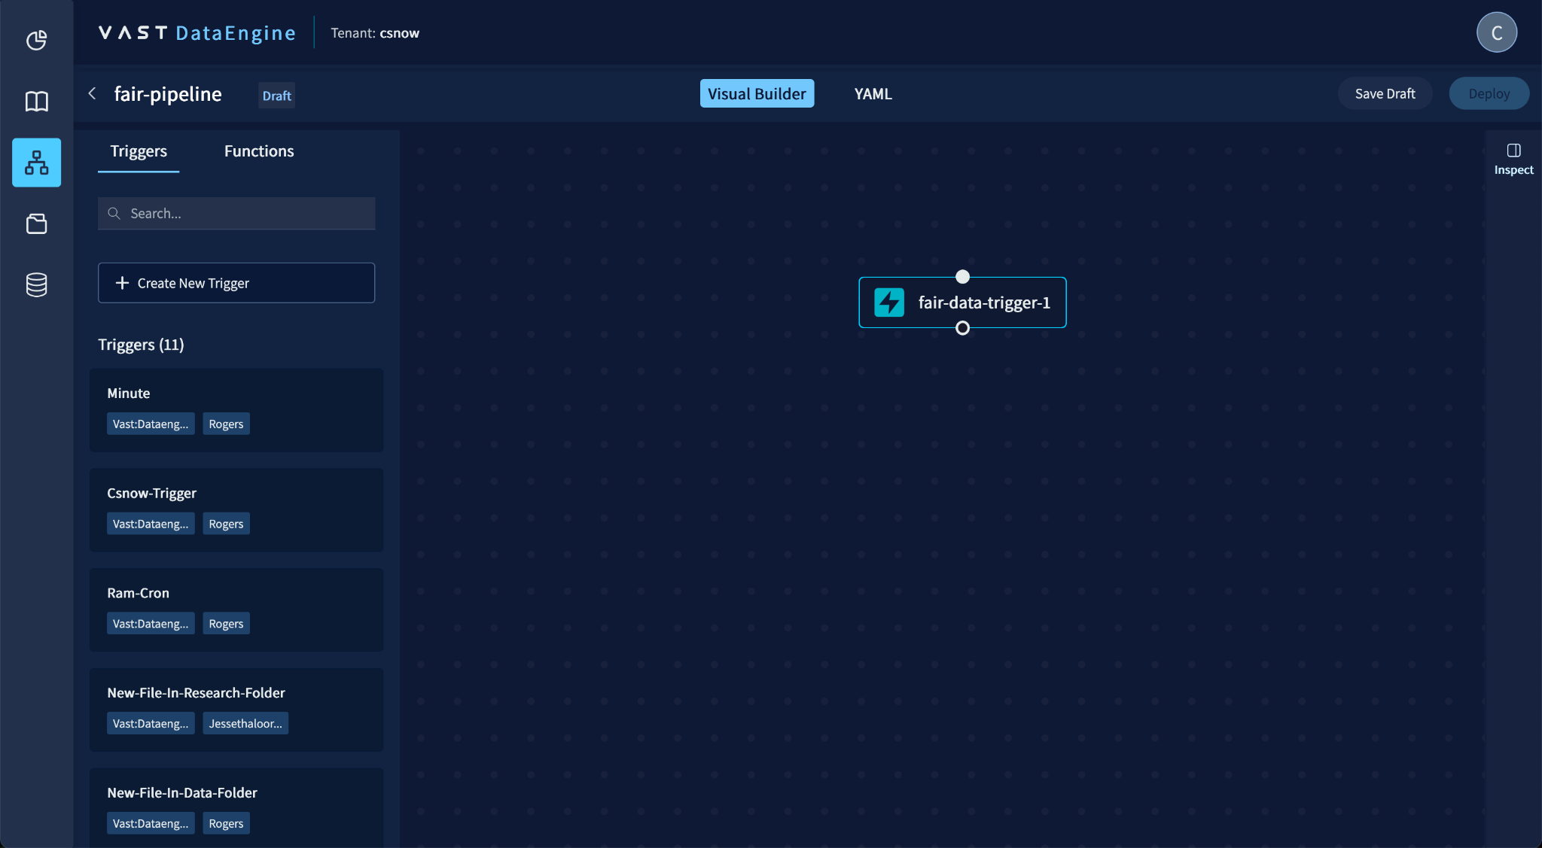

Slide 24
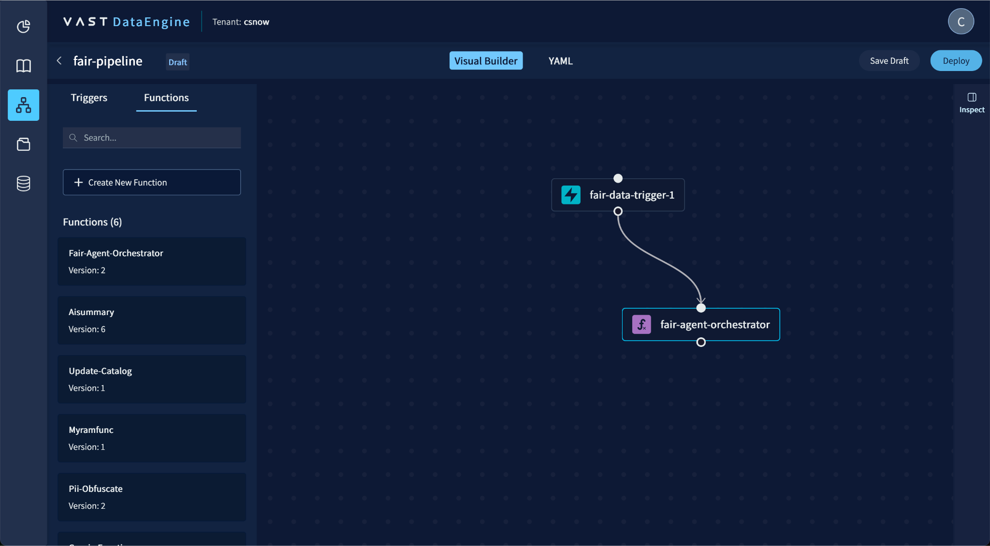

Slide 25
RAG Document Search
Up Next
Overview

Slide 26
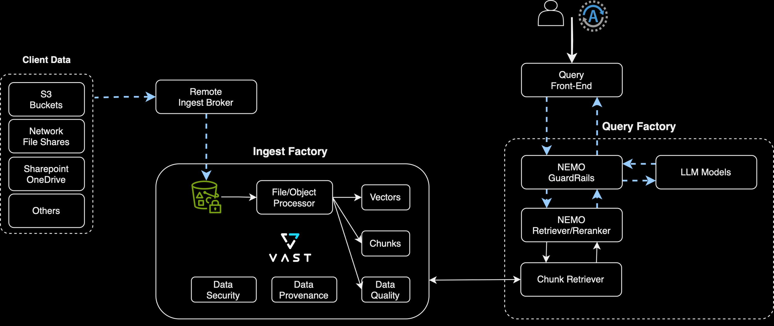
VAST Insight Engine
Fully Integrated Pipelines

Slide 27











The Engine Behind Cross-Domain Discovery
Continuous Data Processing
Data Landscape
Data Embedding Microservices
Text
Office Docs
Metadata
Data Chunks
Knowledge Embeddings
NeMo Curator Microservice
Text & Image Embedding Microservices
Image
PDF
Retrieval Microservices
Enterprise ChatBot or AI Agent
“What is the next two quarter pipeline for…
Text & Image Embedding Microservices
Semantic Embedding of Question
Vector DB or Graph DB
Question
User
SQL Representation of Question
Answer
SQL Retrieval Microservice
Enterprise Data Warehouses
Agent
Application
“The next two quarter pipeline of potential closed business is currently…”
RAG-Powered
Application
NVIDIA NIM (LLM)
Most Relevant Results
Reranking Microservice
Notes:
All right, let’s start by focusing on the first part, which is in the lower left. What you’re seeing there is your chatbot or AI agent and your LLM of choice. On the left, you’ve got your client side—the user or application that’s making the AI query. On the right, you have your agent. This is the model you’ve taken off the shelf from a model builder, and now you’re ready to use it for operations.
Everything else on the screen represents your data landscape—this includes all your enterprise data and the services that make that data available and searchable, allowing the RAG process to work effectively. Let’s break this down a bit further.
Everything circled in red represents your data stores. In the upper left, you see your data lake. In our case, that’s the VAST data store. Down in the lower right, you have the enterprise data warehouse, which in our world is the VAST database. This could be other data warehouses, but for us, it’s the VAST database. Then there’s the vector database or graph database, which serves as the semantic store. This is where the language understanding of the data in your data lake is stored.
How does that happen? This is where the embedding microservices come into play. The job of these services is to take the data from the data lake, chunk it up, run it through a set of embedding services that convert those chunks into vectors or graphs, and then store them in the corresponding vector or graph database. There are many different microservices available for this, including custom-built ones. However, the ones we’re focused on—and that we will be working with in our product—are the NVIDIA NIMS (NVIDIA Inference Microservices). NVIDIA NIMS is a set of large language models (LLMs) either built by NVIDIA or others and included in their NIM catalog. These NIMS handle the embedding function, converting your unstructured data into a vector or knowledge database.
Next, everything below that represents the RAG engine. These are the microservices responsible for executing the RAG query and generating answers. I’ll walk you through how that works.
After the data is vectorized and graphed, here’s the process: The user or application makes a query. The query is sent—let’s say the user asks, “What is the next two-quarter pipeline for XYZ?” The large language model (LLM) probably doesn’t know your company’s pipeline data, so it splits the request into two paths.
First, it triggers a SQL retrieval microservice, pulling a request from the NIM catalog, which converts the query into a SQL query to search the enterprise data warehouse. At the same time, the request is passed to a set of embedding engines. These engines convert the sentence you typed into vectors and perform a similarity search against the vector database. This is akin to the example I mentioned earlier—if I bought toothpaste, what other toothpaste brands might be recommended? In this case, it searches for similar answers related to the pipeline request.
Both the SQL query response and the semantic similarity response are gathered, ranked based on the likelihood of being the most accurate answer, and then passed to the agent. The agent then converts this information into your native language and delivers the final response to the user.
That, in essence, is the RAG process.

Slide 28
Demo: Document RAG Ingest
Up Next
Manually upload example folder_metadata.pdf to make it available for search.
In a production environment, this integration will be automated.

Slide 29
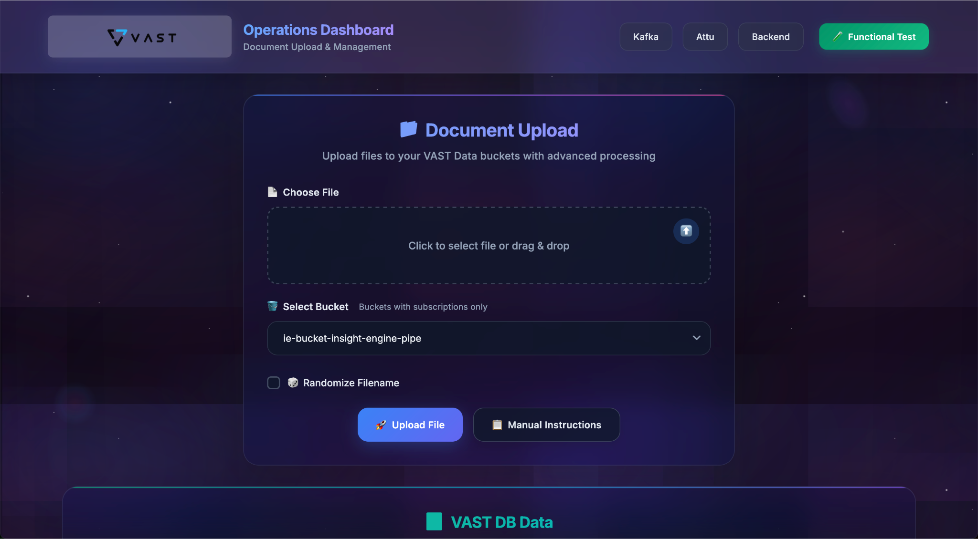

Slide 30
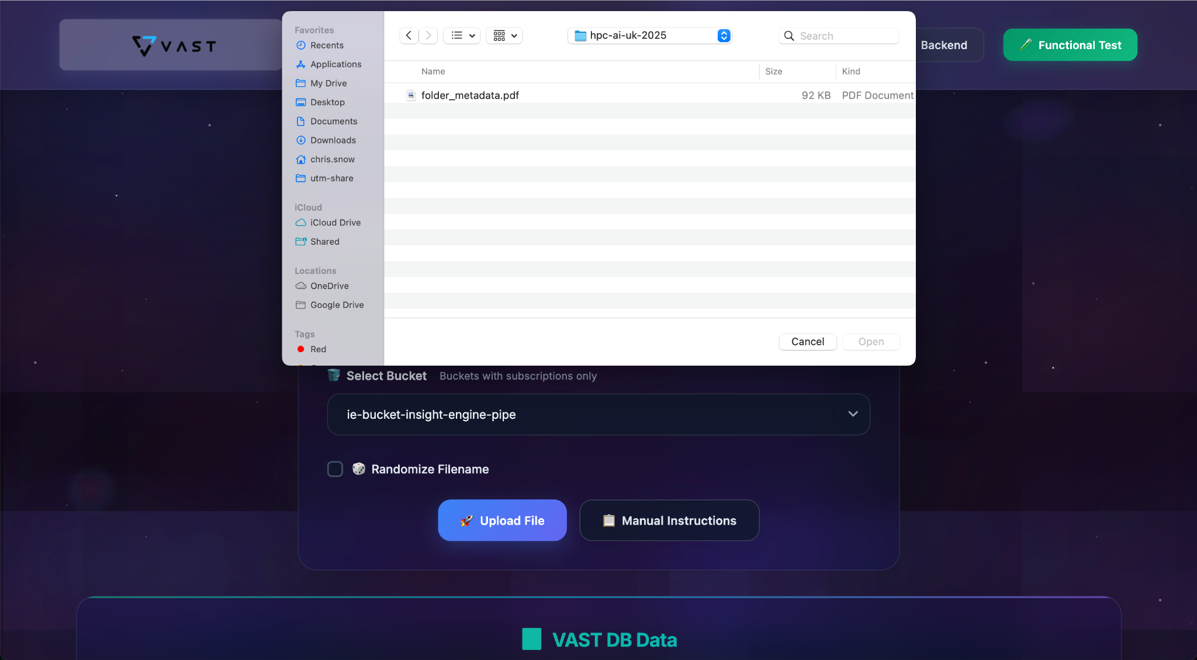

Slide 31
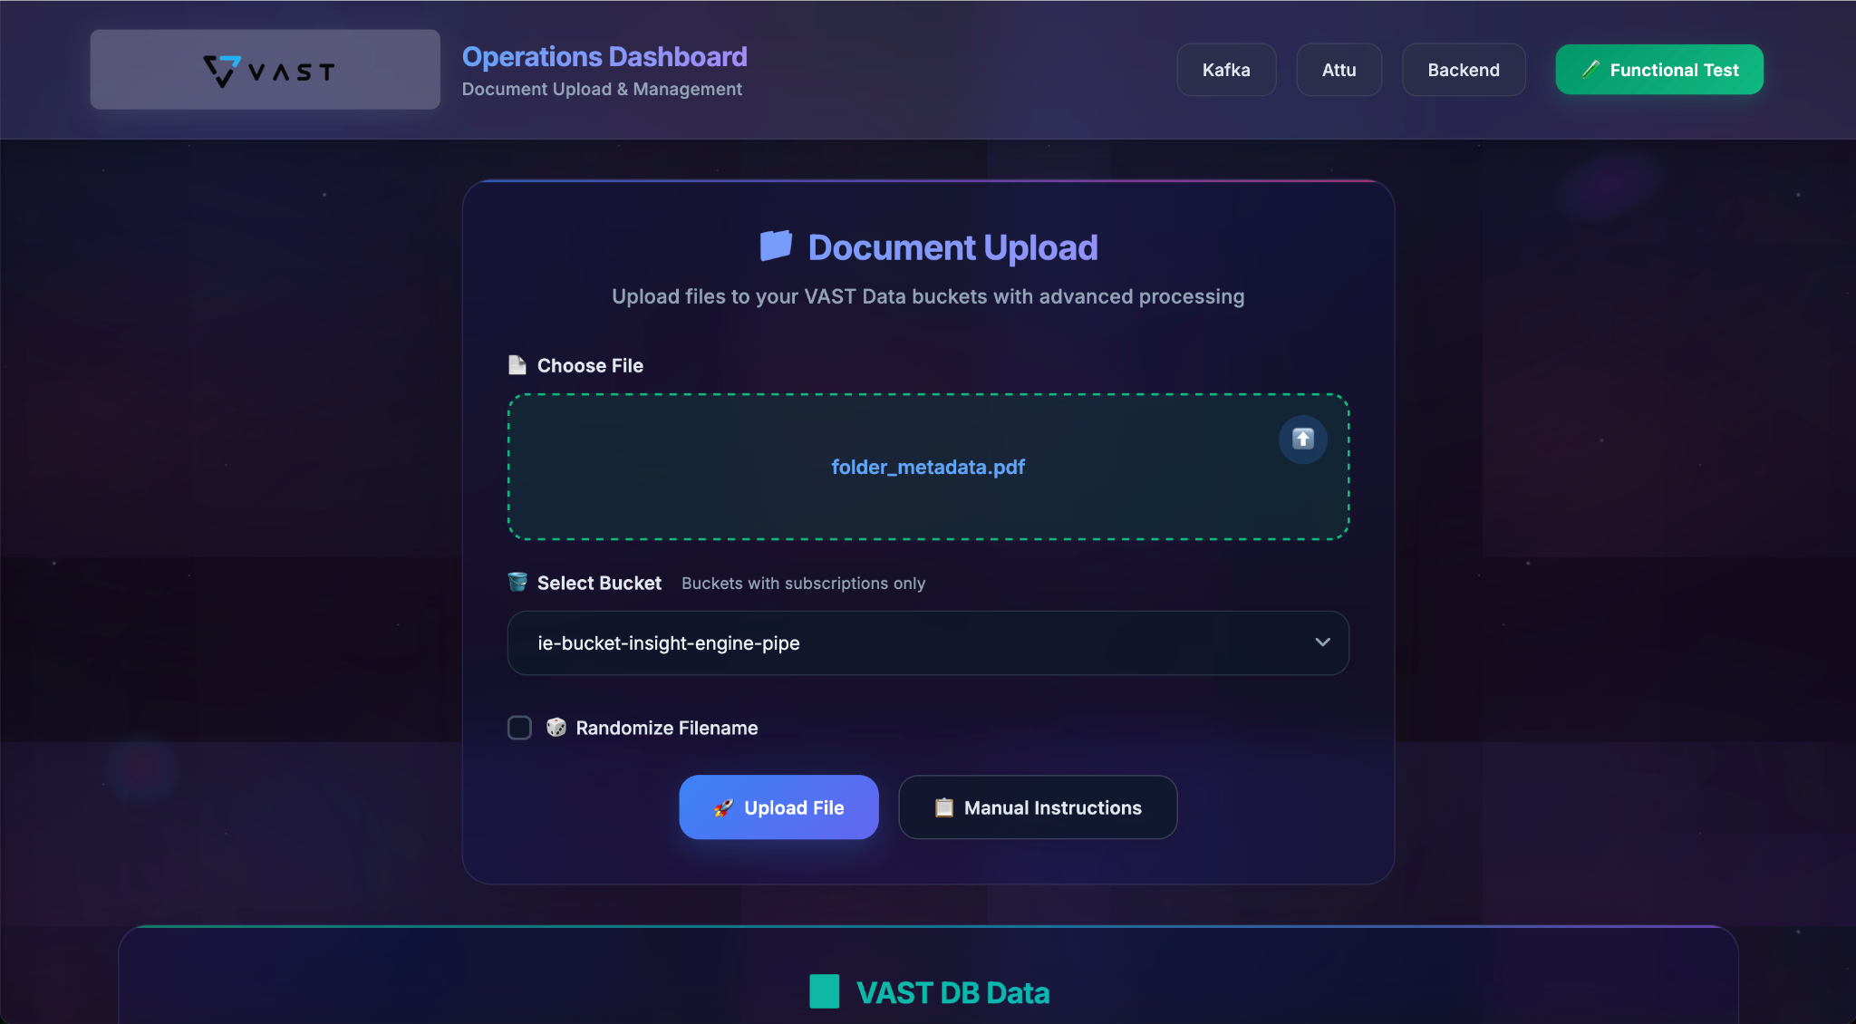

Slide 32
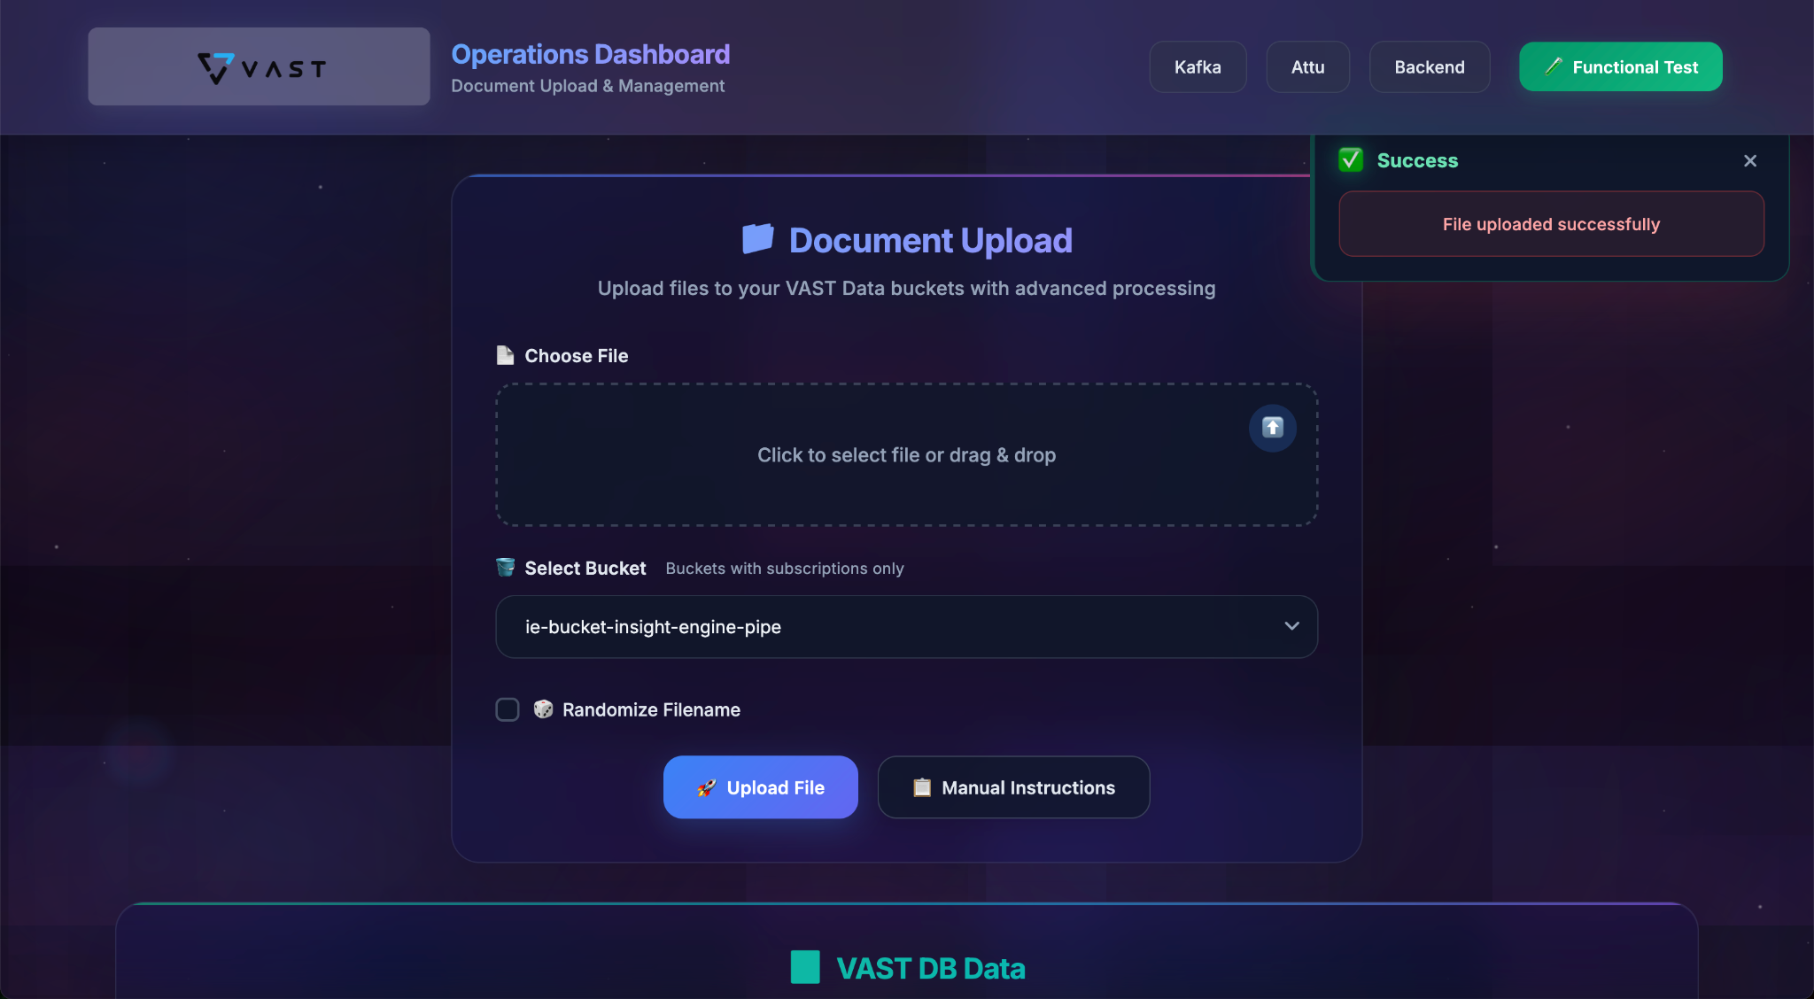

Slide 33
Demo: Document RAG Search
Up Next
Use LLM RAG chat user interface to search for documents.

Slide 34
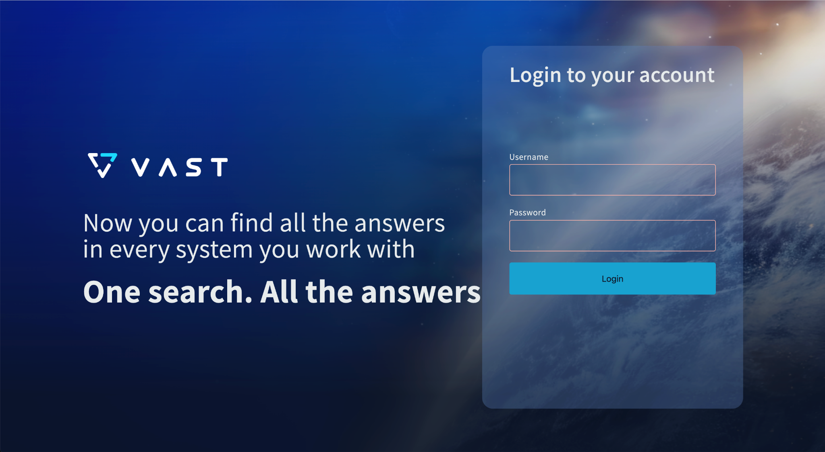

Slide 35


Slide 36
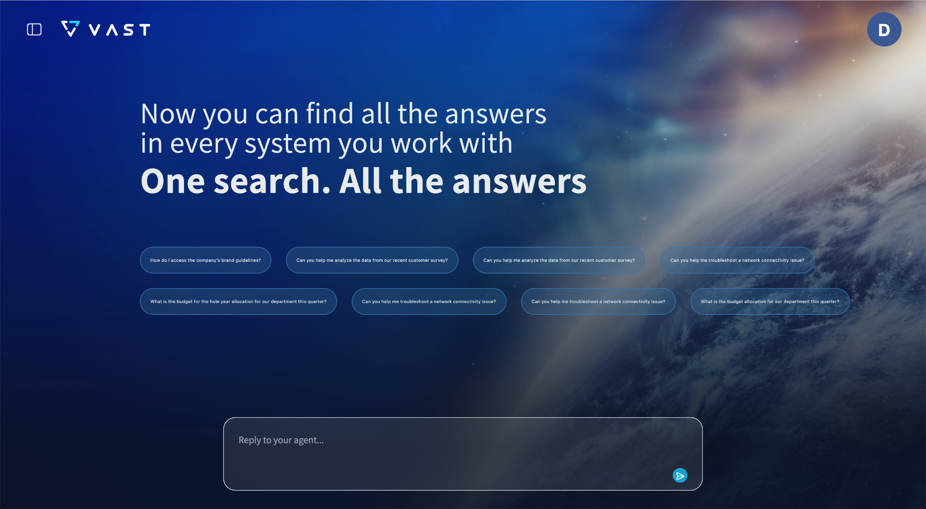

Slide 38
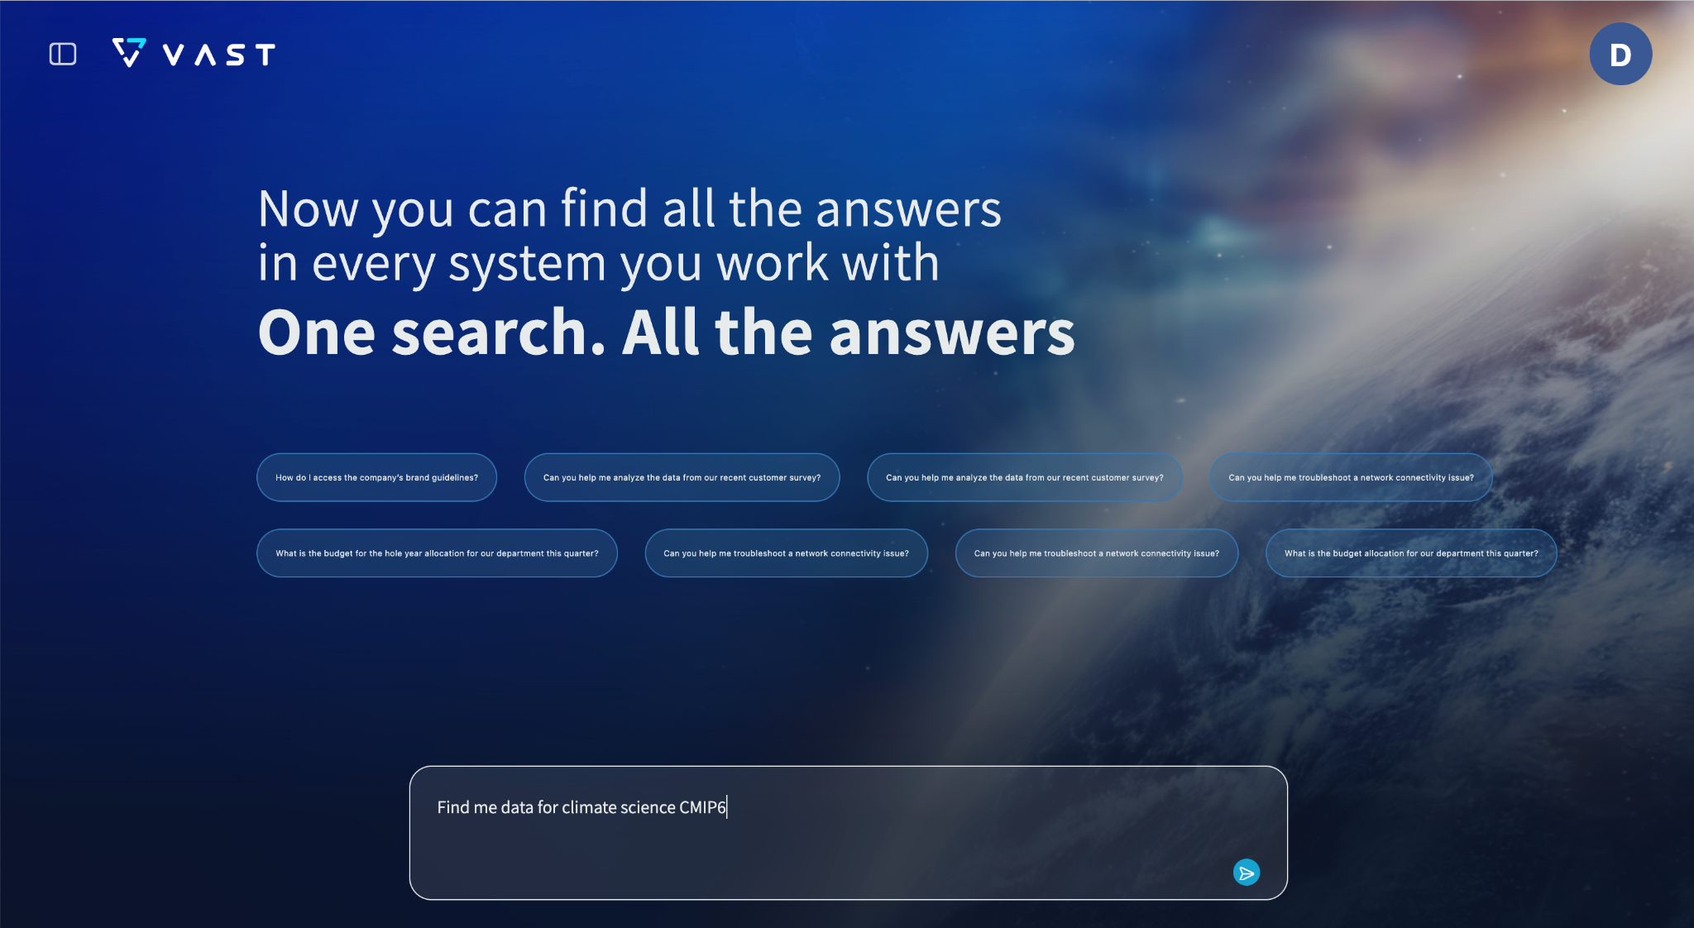

Slide 39
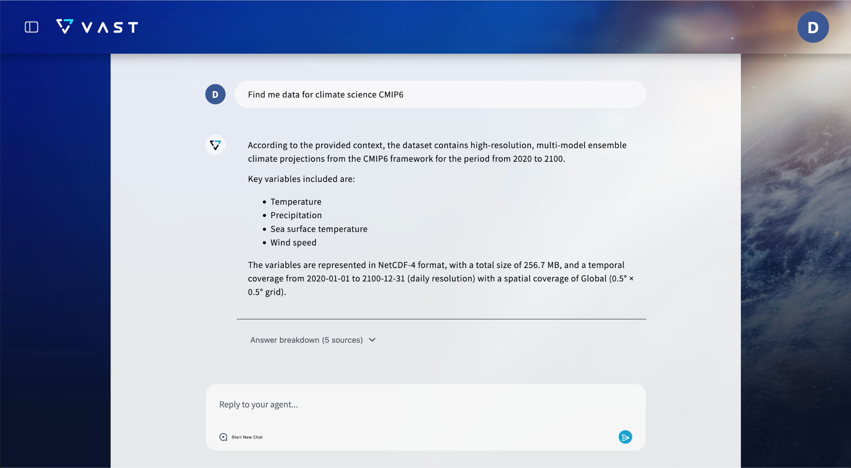

Slide 40
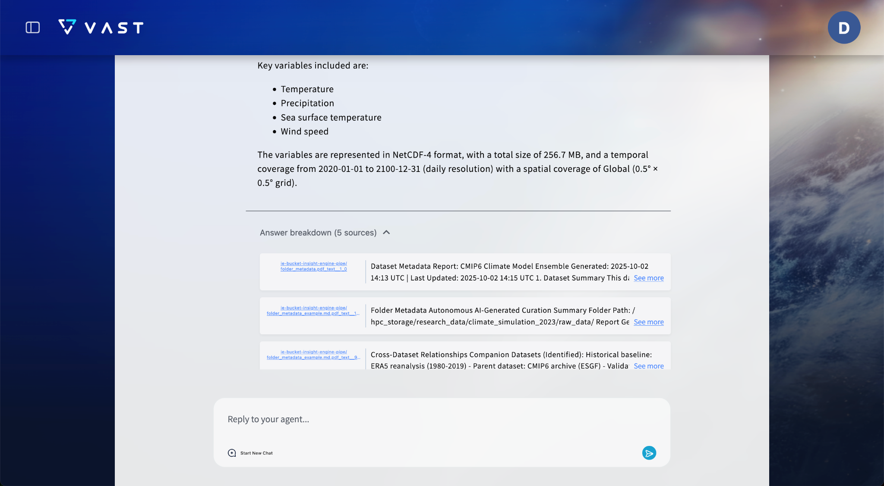

Slide 41
Conclusion
Up Next

Slide 42
Quantified Impact and ROI
90% reduction in data curation overhead
10x faster research discovery is achieved
Immediate ROI from reduced data management
Competitive advantage for grant applications

Slide 43
Getting Started
Team here both days
Booth
James McClung
james.mcclung @vastdta.com
Chris Snow
chris.snow @vastdata.com

Slide 44
Thank You

